Slide 1
Downscaling regional climate model outputs for a comparison of changing snow hydrology along a North American transect from Yukon to Idaho.
Kabir Rasouli and John Pomeroy
Centre for Hydrology & Global Institute for Water Security, University of Saskatchewan, Saskatoon, Canada
Permission to Defend Meeting Saskatoon October 14, 2016

Slide 2
Objectives:
assess the variability and uncertainty in estimations of future alpine hydrological processes and basin hydrology due to uncertainty in climate models;
determine the response of simulated alpine hydrology to climate change and associated transient vegetation change in selected headwaters of the North American Cordillera.

Slide 3
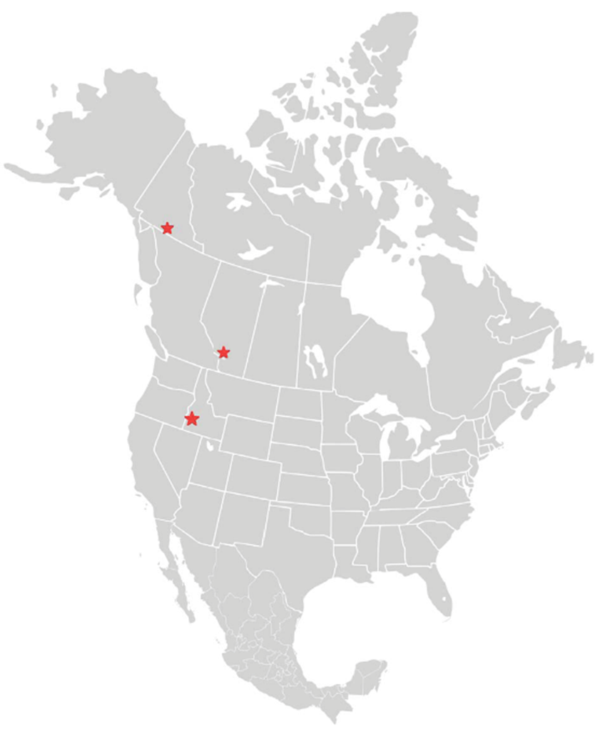
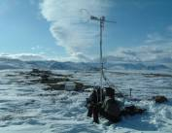
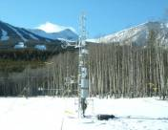
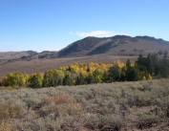
Case Studies along the North American Cordillera
Wolf Creek Research Basin (WCRB), YT
subarctic tundra cordillera
Marmot Creek Research Basin (MCRB), AB
subalpine forest
Reynolds Mountains East (RME), Idaho
mountain rangeland

Slide 4
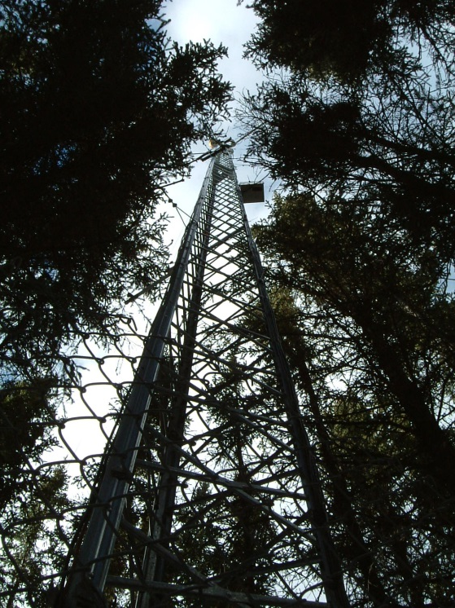
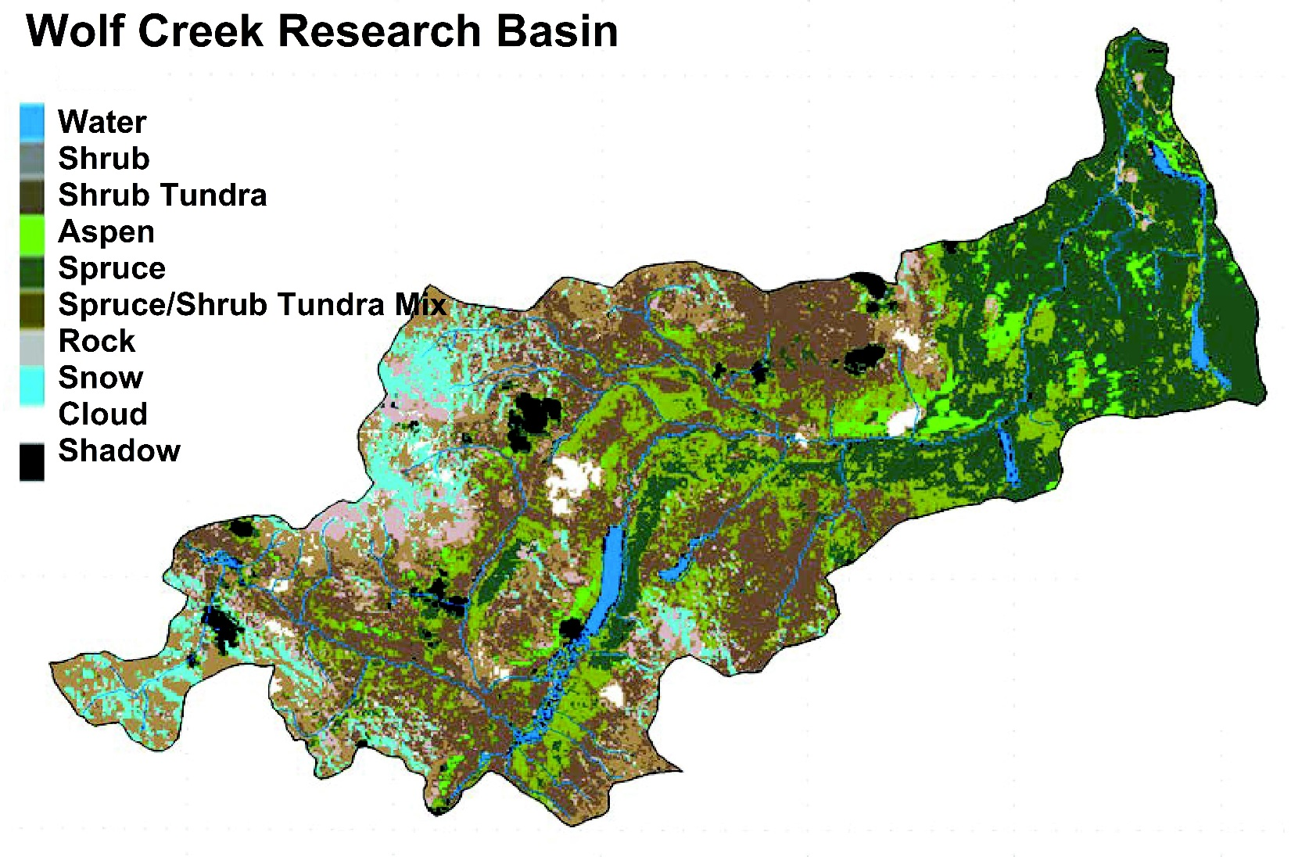
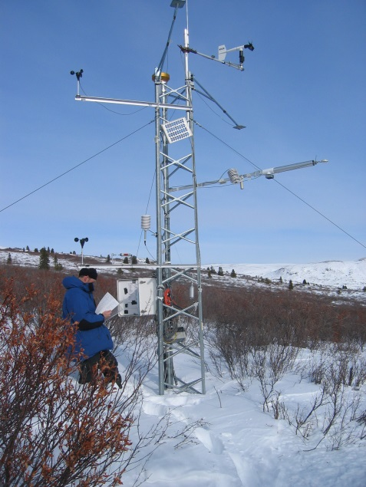
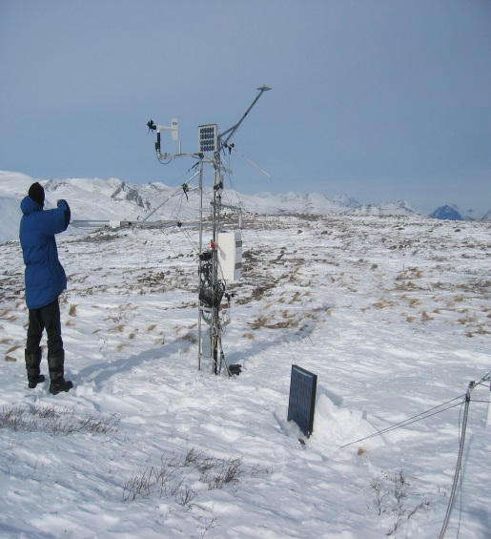
4

Slide 5
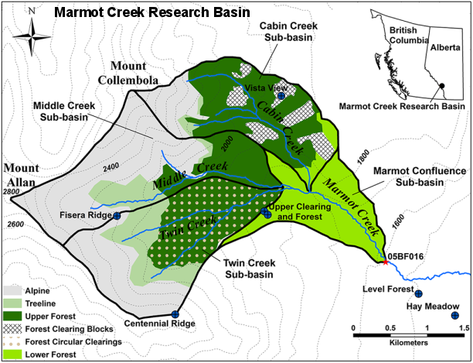

Slide 6
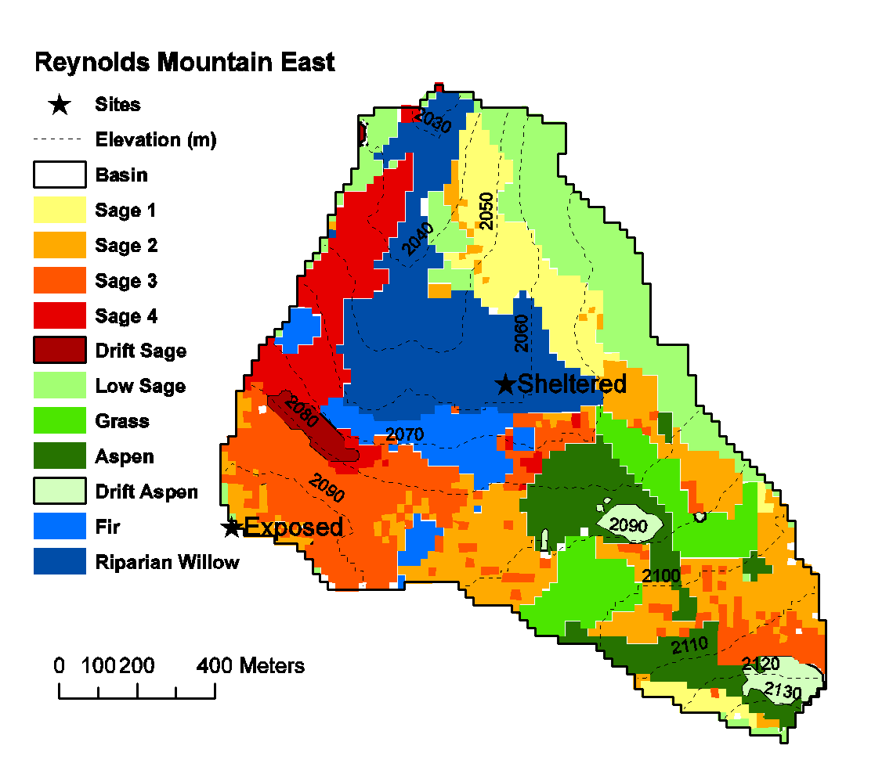

Slide 7
HYDROLOGICAL MODELLING

Slide 8
Cold Regions Hydrological Modelling Platform (CRHM) Mountain Model

Slide 9
Hydrological Model Evaluation
Wolf Creek Research Basin
Calib: NS = 0.64
Reynolds Mountain East
Calib: NS = 0.70
Snow Model Evaluation
Wolf Creek Research Basin
MAE (mm) - RMSE (mm)
Alpine: 28 35
Shrub: 26 32
Forest: 23 29
Reynolds Mountain East
MAE (mm) - RMSE (mm)
26 50

Slide 10
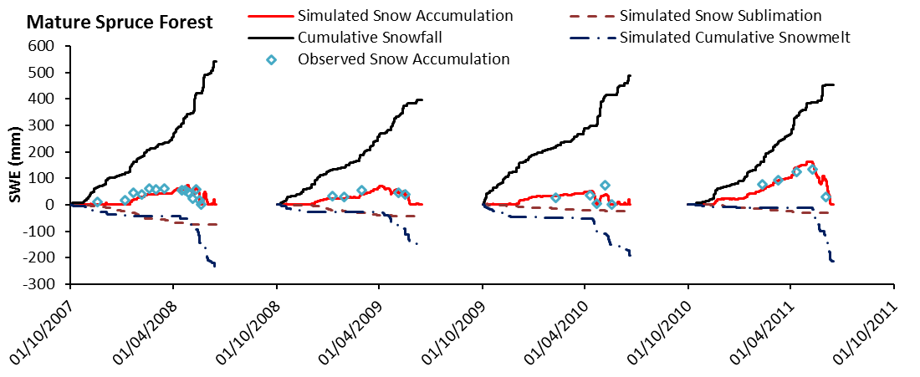
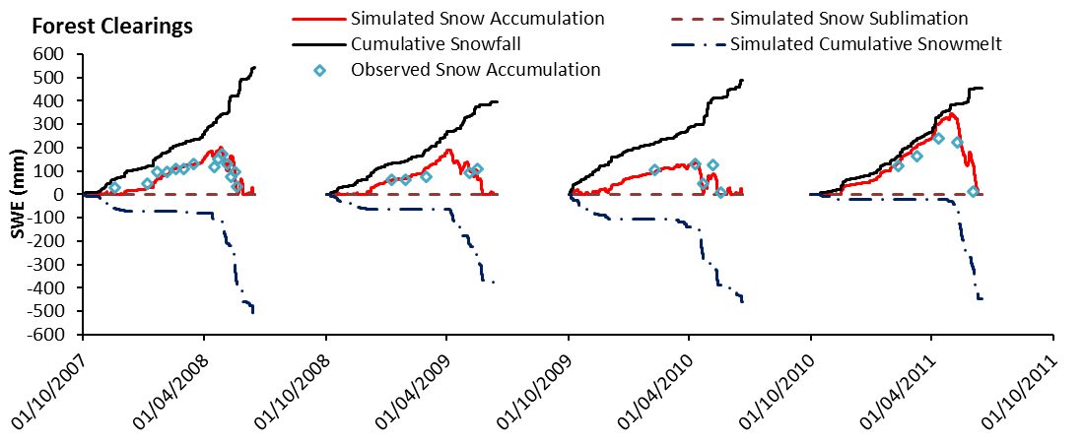
Marmot Creek Snow Model Evaluation
RMSD
19 mm
MB
0.004
RMSD
41 mm
MB
0.12
Fang et al., 2013

Slide 11
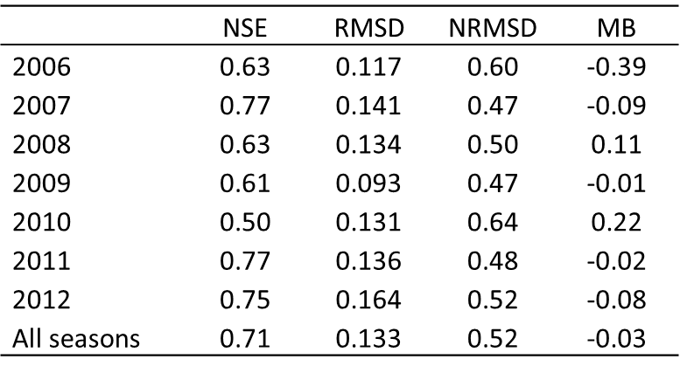
Marmot Creek Hydrological Model Evaluation
Fang and Pomeroy, 2016

Slide 12
North American Regional Climate Change Assessment Program (NARCCAP)
Driving GCM |  | RCM
Community Climate System Model | CCSM | Canadian Regional Climate Model, CRCM
Canadian Global Climate Model 3 | CGCM3 | Canadian Regional Climate Model, CRCM
Geophysical Fluid Dynamics Laboratory | GFDL | Experimental Climate Prediction-2, ECP2
Geophysical Fluid Dynamics Laboratory | GFDL | Hadley Regional Model 3, HRM3
Hadley Centre Coupled Model 3 | HadCM3 | Hadley Regional Model 3, HRM3
Community Climate System Model | CCSM | PSU/NCAR mesoscale model, MM5I
Hadley Centre Coupled Model 3 | HadCM3 | PSU/NCAR mesoscale model, MM5I
Canadian Global Climate Model 3 | CGCM3 | Regional Climate Model version 3, RCM3
Geophysical Fluid Dynamics Laboratory | GFDL | Regional Climate Model version 3, RCM3
Community Climate System Model | CCSM | Weather Research and Forecasting model, updated Grell configuration, WRFG
Canadian Global Climate Model 3 | CGCM3 | Weather Research and Forecasting model, updated Grell configuration, WRFG

Slide 13
Model bias in the current climate
Seasonal bias and daily statistical deviations are much worse.
Humidity and wind speed are poorly represented
Large bias and poor physical basis of statistical downscaling is a serious problem!!!
Notes:
Means written

Slide 14
RCM and OBS Temperature for Current Climate
Wolf Creek
Reynolds Creek

Slide 15
RCM and OBS Precipitation for Current Climate
Wolf Creek
Reynolds Creek

Slide 16
Wolf Creek Dry Days Obs. & WRFG RCM
RCM has too many dry days – particularly in spring during peak flow

Slide 17
Pseudo Future Climate Method (PFC)
PFC approach is introduced in this research adapted from the Pseudo Global Warming method to develop the perturbed climatic fields based:
current monthly 30--year climatology subtracted from the future monthly 30--year climatology.
Observed atmospheric variables
Current period: 1971-2000 - Future period : 2041-2070

Slide 18
Changes applied in Pseudo Future Climate Method (PFC)
Scenarios:
Control period: (1993-2011) for Wolf Creek Research Basin, (1983-2008) for Reynolds Mountain East, and (2006-2014) for Marmot Creek Research Basin
Pseudo-Future Climate (PFC): based on ∆P, ∆Ta, ∆RH, ∆u + Observed control period

Slide 19
Mountains under climate and transient vegetation changes

Slide 20
Impacts of climate and transient vegetation changes on WCRB hydrology and uncertainty due to climate models
Uncertainty of snow and streamflow regimes due to climate model uncertainty is greater than the differences due to climate change.

Slide 21
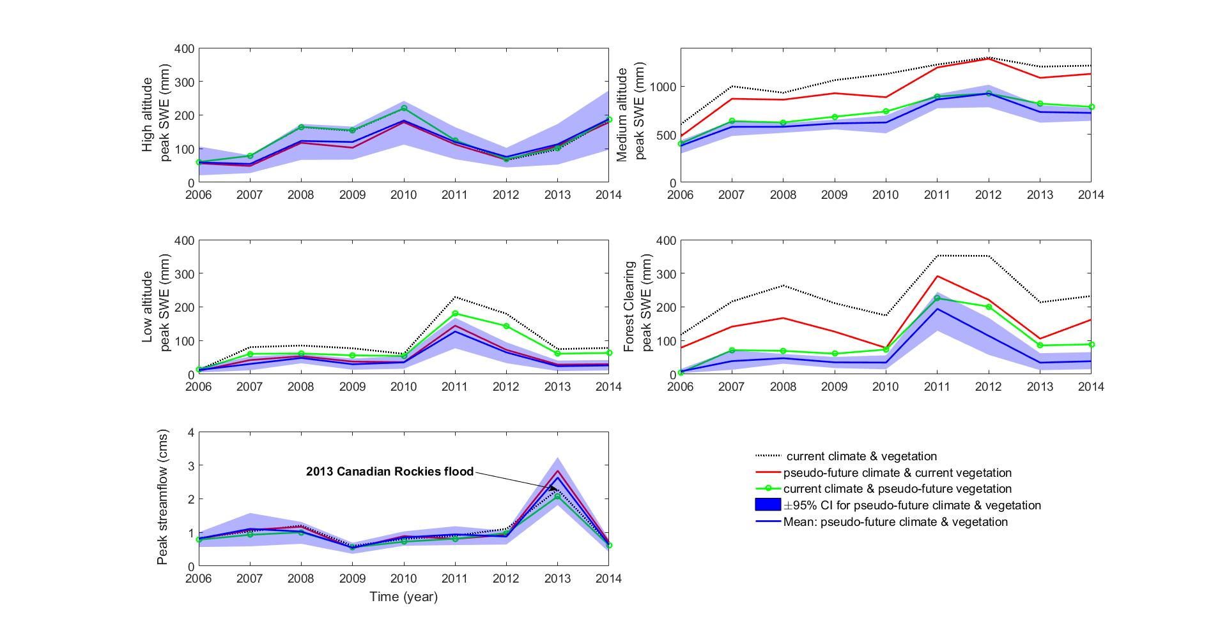
Impacts of climate and transient vegetation changes on MCRB hydrology and uncertainty due to climate models
Uncertainty of high altitude snow and basin streamflow regime due to climate model uncertainty is greater than the differences due to climate change.

Slide 22
Impacts of climate and transient vegetation changes on RME hydrology and uncertainty due to climate models
Uncertainty of snow regime due to climate model uncertainty is smaller than the differences due to climate change. Opposite is true for streamflow.

Slide 23
Snow inter-annual variability under current and pseudo-future climates and vegetation change
∆peak SWE : from 133 to 118 mm (-20%) 183 to 136 mm (-42%) 368 to 168 mm (-54%)
early peak SWE : 24 days 5 days 34 days

Slide 24
Snow Regime Change (changes given inside parentheses)
Basin | Variable | Unit | Control | Climate | Vegetation | combined
 |  |  | period | change | change | change
WCRB | peak SWE | [mm] | 133 | 118 (-12) | 118 (-11) | 107 (-20)
 | peak SWE date | [day of year] | 186 | 164 (-22) | 182 (-4) | 162 (-24)
 | Snow season length | [day] | 224 | 208 (-16) | 226 (2) | 215 (-9)
MCRB | peak SWE | [mm] | 183 | 141 (-23) | 136 (-26) | 106 (-42)
 | peak SWE date | [day of year] | 210 | 200 (-10) | 211 (1) | 205 (-5)
 | Snow season length | [day] | 283 | 248 (-35) | 284 (1) | 246 (-37)
RME | peak SWE | [mm] | 368 | 196 (-47) | 326 (-11) | 168 (-54)
 | peak SWE date | [day of year] | 161 | 129 (-32) | 162 (1) | 127 (-34)
 | Snow season length | [day] | 211 | 161 (-50) | 213 (2) | 171 (-40)

Slide 25
Streamflow Regime Change (changes given inside parentheses)
Basin | Variable | Unit | Control | Climate | Vegetation | combined
 |  |  | period | change | change | change
WCRB | total annual runoff | [mm] | 152 | 178 (18) | 131 (-14) | 157 (3)
 | peak runoff | [cms] | 3.2 | 3 (-7) | 2.5 (-21) | 2.5 (-22)
 | peak runoff date | [day of year] | 206 | 195 (-11) | 211 (5) | 183 (-23)
 | runoff ratio | [-] | 0.4 | 0.39 (-1) | 0.37 (-7) | 0.37 (-7)
MCRB | total annual runoff | [mm] | 402 | 426 (6) | 336 (-16) | 359 (-11)
 | peak runoff | [cms] | 1.01 | 1.11 (9) | 0.91 (-10) | 0.98 (-3)
 | peak runoff date | [day of year] | 254 | 253 (-1) | 254 (0) | 256 (2)
 | runoff ratio | [-] | 0.40 | 0.40 (0) | 0.34 (-14) | 0.35 (-13)
RME | total annual runoff | [mm] | 371 | 375 (1) | 340 (-8) | 351 (-5)
 | peak runoff | [cms] | 0.053 | 0.05 (-15) | 0.05 (-16) | 0.04 (-17)
 | peak runoff date | [day of year] | 226 | 186 (-40) | 226 (0) | 179 (-47)
 | runoff ratio | [-] | 0.44 | 0.41 (-6) | 0.42 (-5) | 0.40 (-8)

Slide 26
Conclusions
Hydrological uncertainty due to climate model uncertainty and the effects of internannual variability can be greater than the differences due to climate change.
Snow regime uncertainty due to climate model uncertainty and the effects of internannual variability is greater in WCRB and the high altitudes of MCRB, but smaller in RME and the low altitudes in MCRB than the differences due to climate change.
Transient vegetation change is as important as climate change in decreasing the peak SWE and the annual peak runoff in all three basins. However, the response of annual runoff volume to change varies with latitude.
WCRB in the north has the most insensitive snowpack to climate change, whilst snowpacks in RME in the south are the most sensitive. MCRB snowpack sensitivity decreases with altitude.
Annual runoff volume will increase under climate change in the north but not the south and will decrease under combinations of climate and transient vegetation change.

