Slide 1

Proposed GEWEX GHP Mountain Hydrology Cross-cut Project:
INARCH: International Network for Alpine Research Catchment Hydrology
Proposer and Contact: John Pomeroy,
Centre for Hydrology & Global Institute for Water Security,
University of Saskatchewan, Canada
www.usask.ca/hydrology john.pomeroy@usask.ca
Notes:
1

Slide 2
Co-Proposers
Lugwig Braun, Bavarian Academy of Sciences & Humanities, Germany
Karsten Schulz, BOKU, Vienna, Austria
Matthias Bernhardt, BOKU, Vienna, Austria
Xin Li, CAREERI, Chinese Academy of Sciences, Lanzhou, China
Richard Harding, Centre for Ecology & Hydrology, Wallingford, England
James McPhee, Dept. of Civil Engineering, University of Chile, Santiago, Chile
Nick Rutter, Dept. of Geography, University of Northumbria, Newcastle, England
Peter Jansson, Dept. of Physical Geography, Stockholm University, Sweden
Joseph Shea, ICIMOD, Nepal
Ignacio Lopez Moreno – CSIC, Institute for Pyrenean Ecology, Zaragoza, Spain
Yaoming Ma, Institute for Tibetan Plateau, Chinese Academy of Sciences, Beijing, China
Vincenzo Levizzani, Institute of Atmospheric Sciences & Climate, Bologna, Italy
Ulrich Strasser, Institute of Geography, University of Innsbruck, Austria
Georg Kaser, Institute of Meteorology & Geophysics, University of Innsbruck, Austria
Anil Mishra, International Hydrological Programme, UNESCO, Paris, France
Isabella Zin, LTHE, Grenoble, France
Vincent Vionnet, Meteo France, Grenoble, France
Martyn Clark, NCAR, Boulder, USA
Roy Rasmussen, NCAR, Boulder, USA
Richard Essery, School of Geosciences, University of Edinburgh, Scotland
Tobias Jonas, SLF, Davos, Switzerland
Walter Immerzeel, Universiteit Utrecht, Netherlands
Danny Marks, USDA ARS, Boise, USA
Alain Pietroniro, Water Survey of Canada, Environment Canada
Rick Janowicz, Yukon Environment, Canada

Slide 3
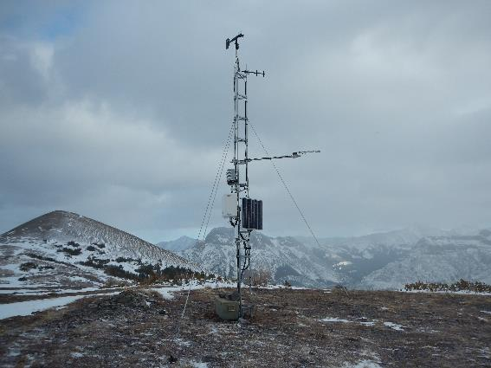
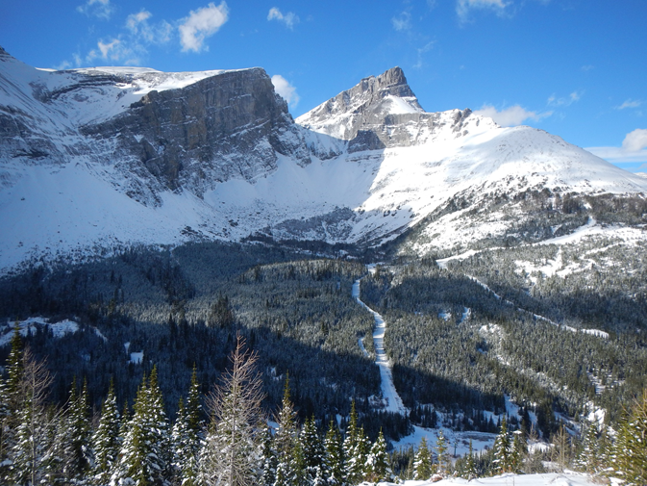
Urgency
to IPCC (2014) WG II report – “In many regions, changing precipitation or melting snow and ice are altering hydrological systems, affecting water resources in terms of quantity and quality”
Alpine catchments receive and produce a disproportionately large fraction of global precipitation and runoff including contributions to floods and water supply for vast downstream areas.
Snowfall does not equal accumulation on the ground!
Snow, ice, and phase change domination of alpine hydrology means that it is especially sensitive to temperature change.

Slide 4
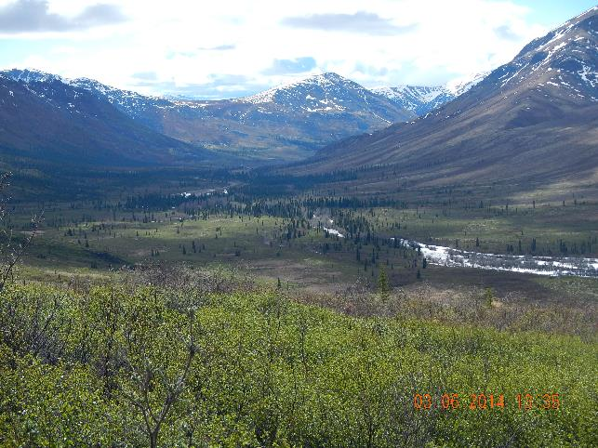
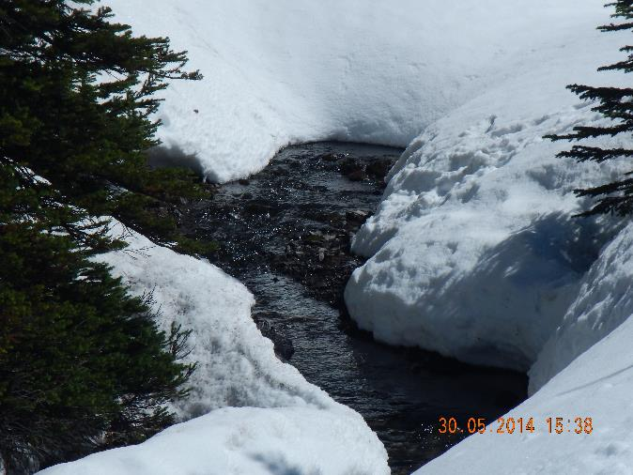
Significance
Understanding the sensitivity of alpine hydrological processes to changing high elevation climate is of disproportionate importance to global water and energy exchange and downstream water resources.
Ongoing change in climate has already resulted in shorter seasonal snowcover duration, earlier spring hydrographs, greater rainfall fraction of total precipitation, glacier volume decline, ground thaw and woody vegetation increase in many alpine catchments.
Some alpine catchments are contributing to higher frequency of floods and/or droughts.

Slide 5
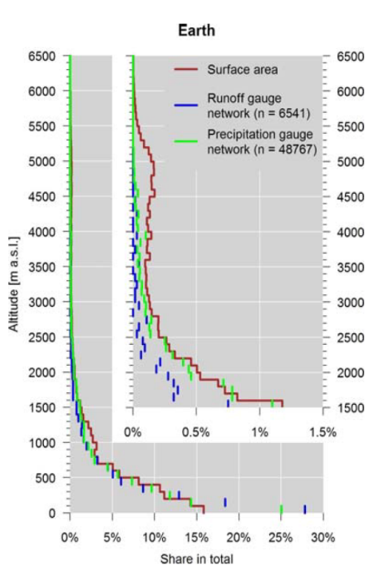
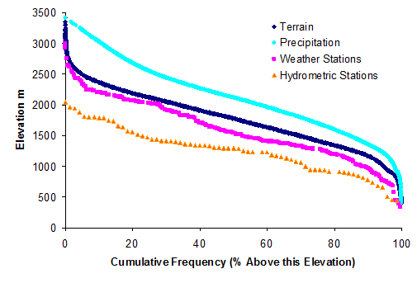
Alpine Regions are Data Scarce
Left Side: Altitudinal distribution of global runoff stations represented in the GRDC archive and global precipitation station network represented in the GPCC archive compared to global hypsography of the land surface area (without Greenland and Antarctica). The inset shows a magnification for altitudes above 1500ma.s.l. (Viviroli et al. 2011).
Right Side: Hypsometric curve of cumulative frequency (or percentage above this elevation) for terrain area, volume of precipitation, number of weather stations and number of hydrometric stations as a function of elevation in the Canadian Rocky Mountain National Parks (UNESCO World Heritage Site) and a 50 km buffer zone around them (Pomeroy, Sinclair – in preparation).

Slide 6
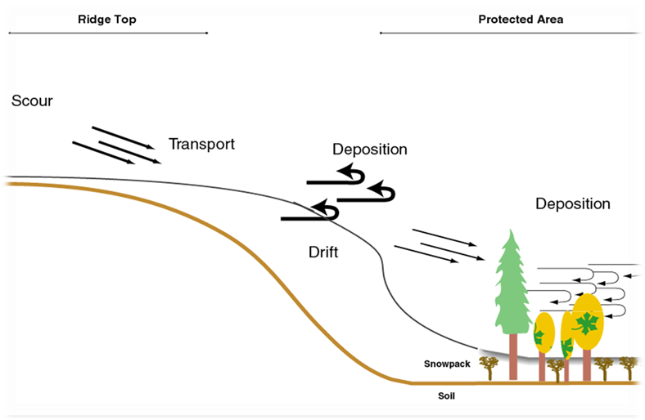

Research Need
A concerted global effort is needed to address how changing high mountain hydrological processes will mediate the influence of atmospheric change in alpine catchments.

Slide 7
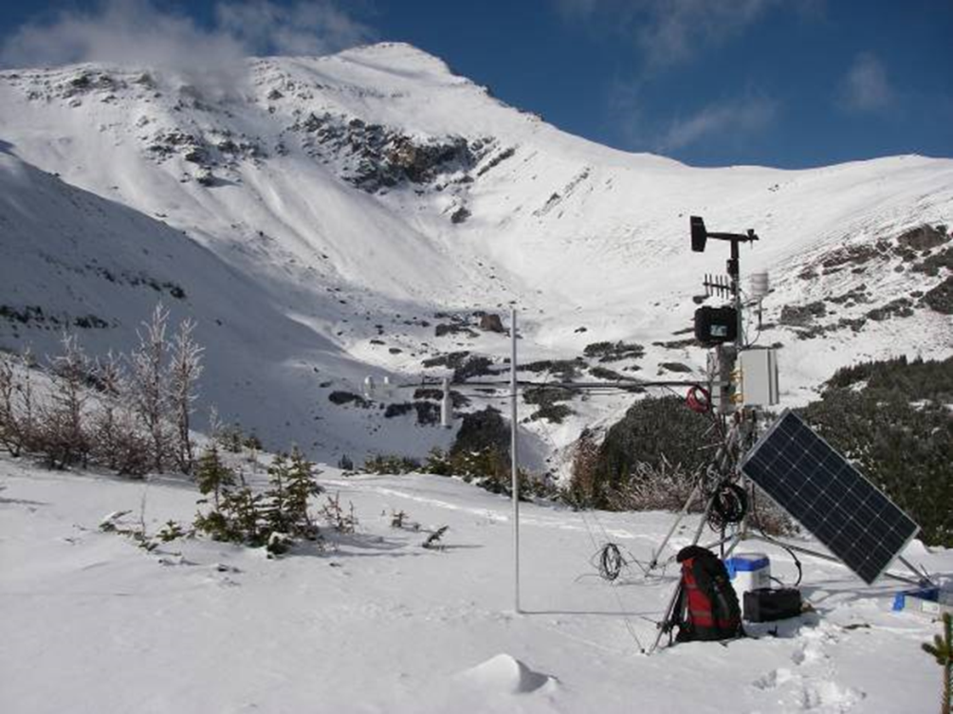
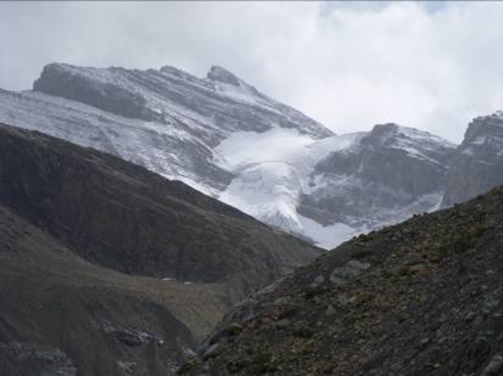
Objectives
Overall: to better understand alpine cold regions hydrological processes, improve their prediction and find consistent measurement strategies.
To achieve this objective it is necessary to develop transferable and validated model schemes of different complexity that can support research in data sparse mountain areas dominated by elements of snow, permafrost and glacier cover.

Slide 8
Sub-Objectives
  How different are the measurement standards and the standards for field sampling and do we expect distinctive differences in model results and hydrological predictability because of the sampling schemes, data quality and data quantity?
  How do the predictability, uncertainty and sensitivity of catchment energy and water exchange vary with changing atmospheric dynamics in various high mountain regions of the Earth?
  What improvements to high mountain energy and water exchange predictability are possible through improved physics in land surface hydrological models, improved downscaling of atmospheric models in complex terrain, and improved approaches to data collection and assimilation of both in-situ and remotely sensed data?
  Do the existent model routines have a global validity, are they transferable and are they meaningful in different mountain environments?
  How do transient changes in perennial snowpacks, glaciers, ground frost, soil stability, and vegetation impact models of water and energy cycling in high mountain catchments?

Slide 9
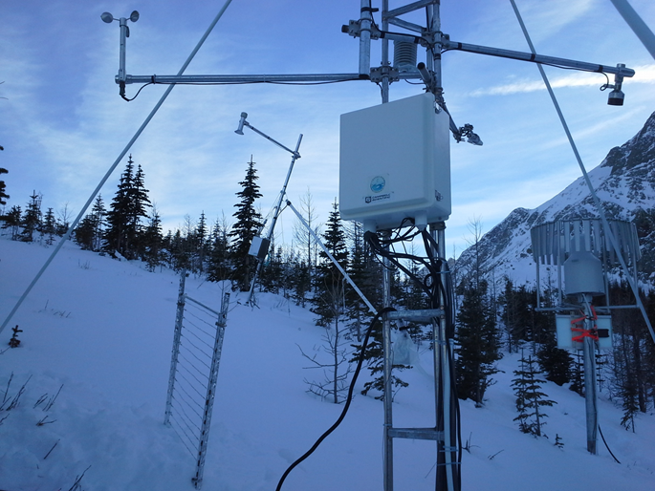
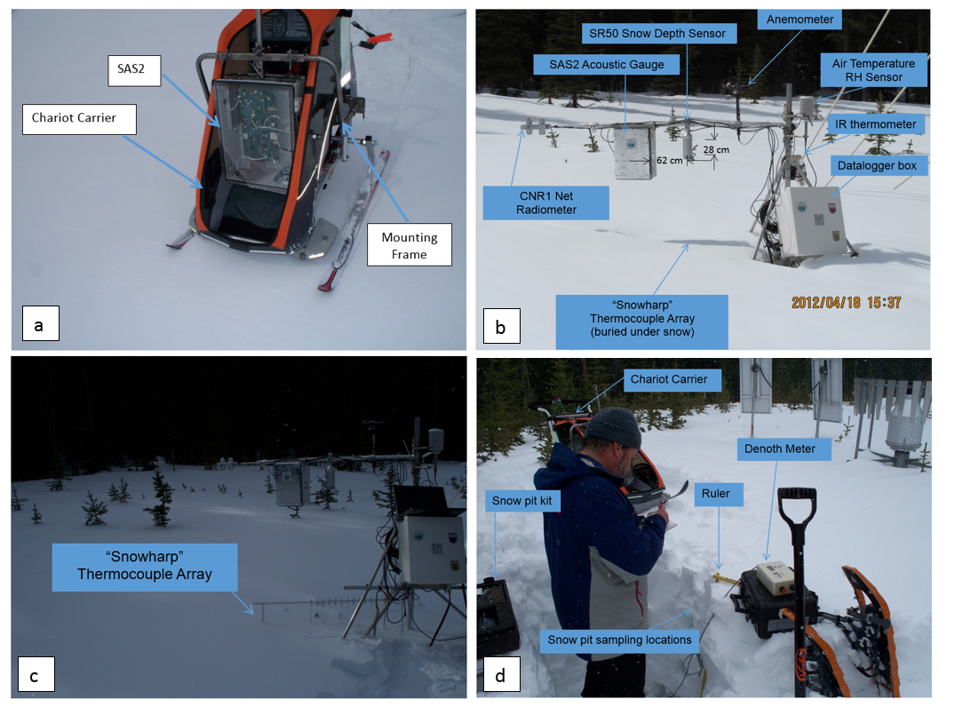
Data Requirements
Surface based data requirements for this project will primarily be met by
  openly-available detailed meteorological and hydrological observational archives from long-term research catchments at high temporal resolution in selected heavily instrumented alpine regions,
  atmospheric model reanalyses,
  downscaled climate model as well as regional climate model outputs.

Slide 10
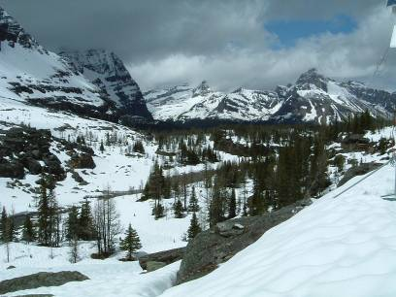
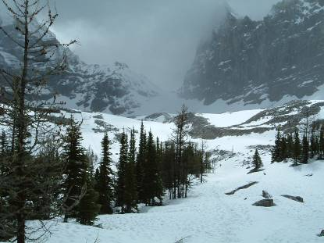
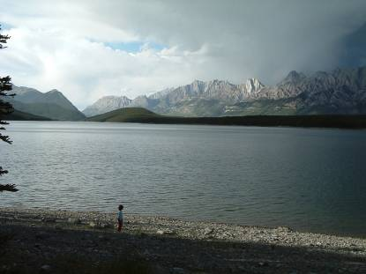
Data Standards
At least 5 years of continuous data with hourly sampling intervals for meteorological data, daily precipitation and streamflow, and regular snow and/or glacier mass balance surveys
The ideal sites will be Integrated Alpine Observing and Predicting Systems (IAOPS). IAOPS are classified for assessment as:
  CLASS A: sites receiving technology transfer and developing towards CLASS B to E.
  CLASS B: Single measurement points with highly accurate driving data and snow or glacier data,
  CLASS C: gauged catchments that contain Class B sites and detailed vegetation coverage, soils, topography, snowcovered area, glacier mass balance or permafrost information,
  CLASS D: domains for which high resolution gridded meteorological data is available that includes CLASS C sites,
  CLASS E: the same as CLASS D but gridded meteorological data is also available as climate change scenarios.

Slide 11
Activities
Facilitate exchange and collaboration by
  comparing instrumentation best practices,
  suggesting improvements in instrumentation,
  developing reliable alpine datasets for model testing and numerical experiments
Improve algorithm development by
  conducting process algorithm intercomparisons,
  defining optimal characteristic parameterisations
  conducting uncertainty analyses to quantify algorithm reliability.
Examine hydrological model sensitivity to atmospheric change in global alpine environments focussing on
  snowpack, permafrost, glacier mass balance, groundwater and vegetation changes.
Demonstrate improvements to model predictability that can be realised from data assimilation, downscaling and model structural improvements.
Exploration of the ability of different regional scale meteorological model setups and parameterisations to reproduce mountain forcing fields.
Evaluation of different downscaling schemes from meteorological to hydrological models in mountains.
Foster research and development activities and coherent planning for future observing schemes and international network optimization.
Facilitate education and training programmes to build and enhance capacities at various levels and popularize science results with the public.

Slide 12
Alpine Hydrological Model Toolbox derived from Cold Regions Hydrological Model
Model components
  Blowing snow redistribution, sublimation and melt
  Forest and shrub canopy effects
  Actual evapotranspiration,
  frozen & unfrozen soil infiltration,
  soil moisture and groundwater balance,
  routing
Ability to perturb the model
via temperature and
preciptiation changes
  Affects precipitation phase
  Affects hydrological processes

Slide 13
Reynolds Creek, Idaho, USA
Impact of Sheltering
1 C
1 C
Rasouli et al. in review

Slide 14
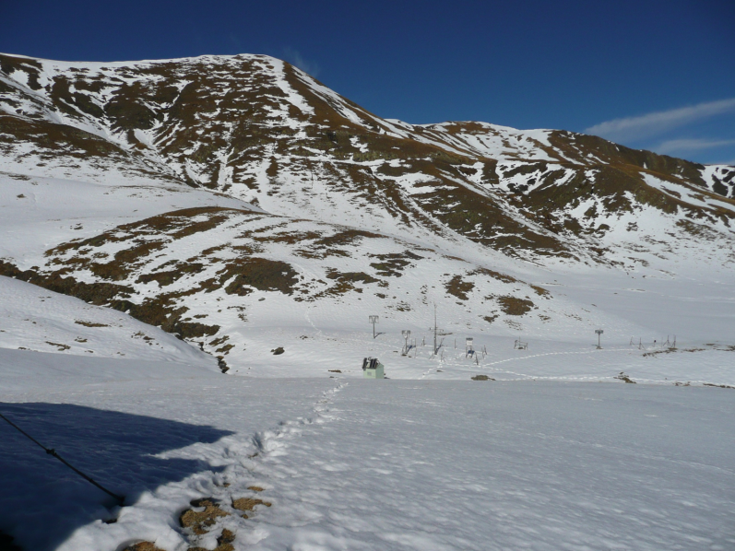
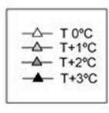
Effect of Aspect on Peak SWE and
Snow Duration – Izas, Pyrenees
Long-term average difference (%) in the annual maximum snow accumulation (MSWE) and snow duration of the snow pack (DSP) for each slope aspect compared with flat conditions.
Lopez-Moreno et al 2014
Notes:
De nuevo ausencia de datos

Slide 15
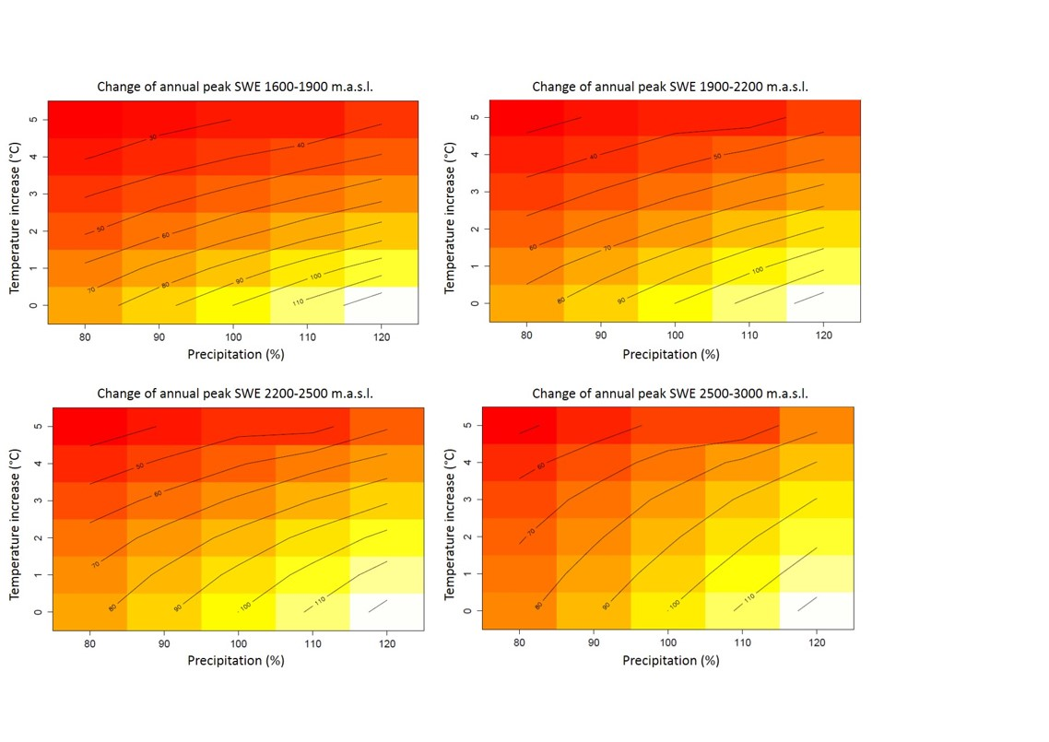
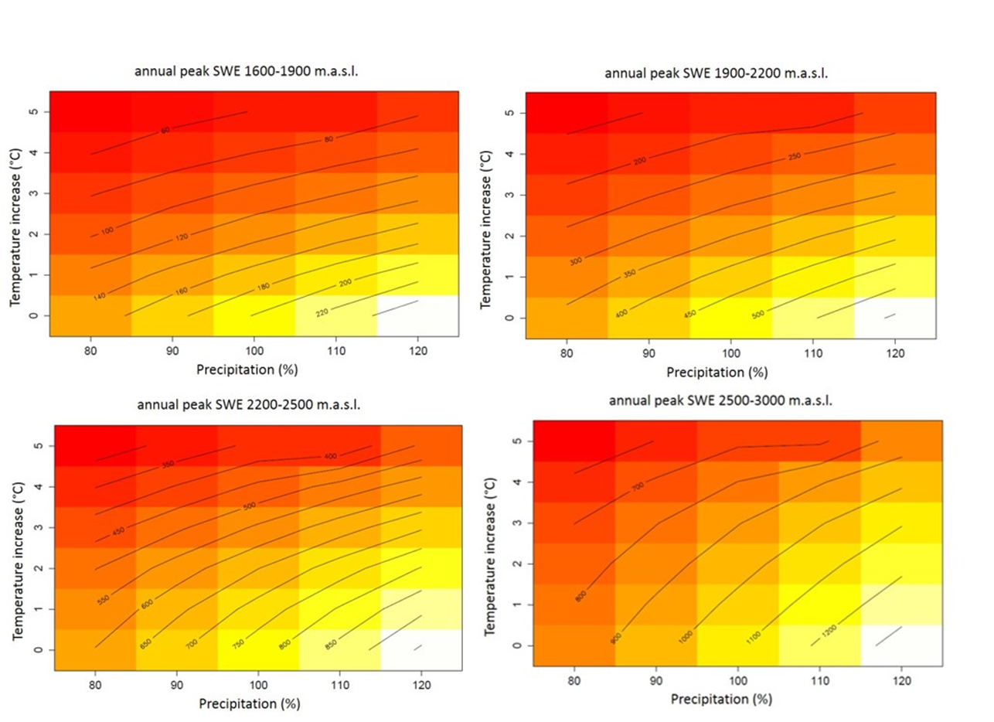
Zugspitze, Germany – Altitude Effects
1.5 C
1 C
3 C
2 C
Weber et al. 2015

Slide 16
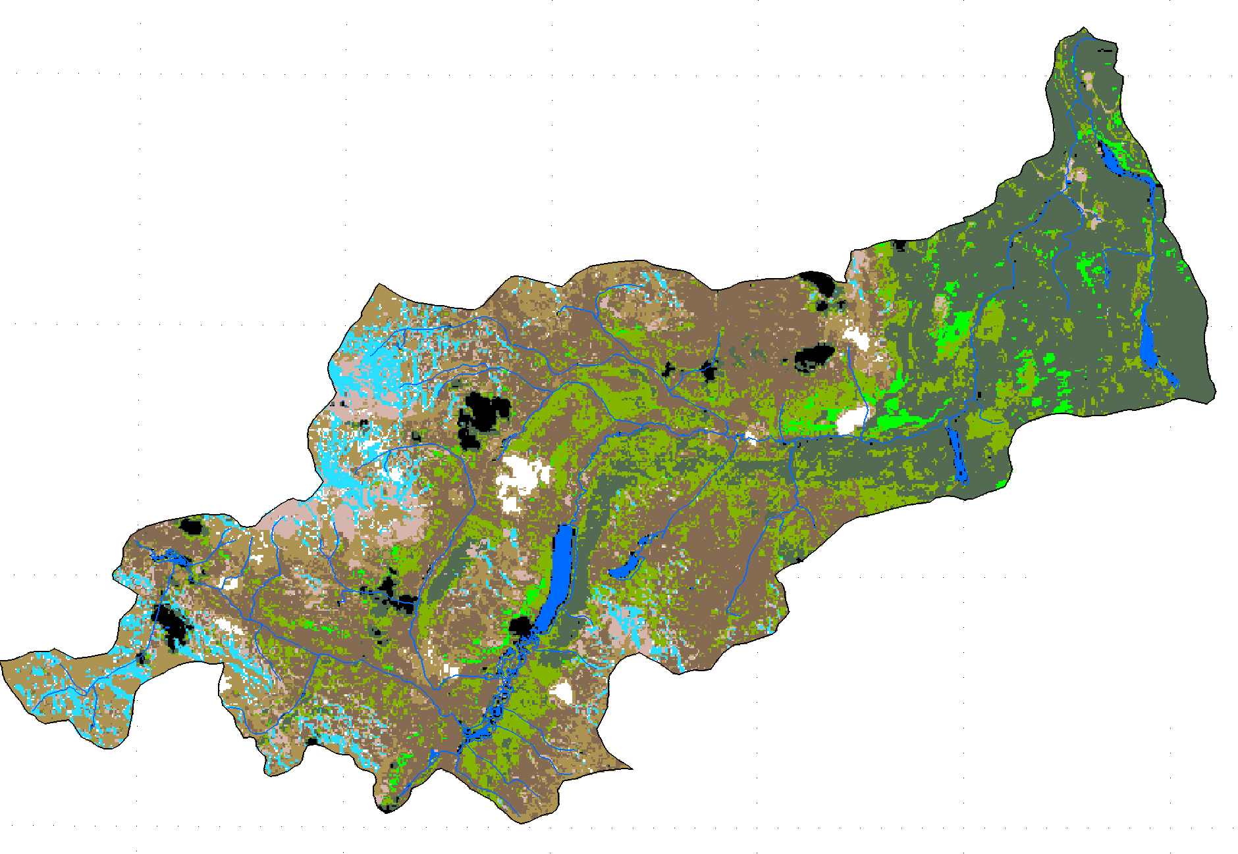
Wolf Creek, Yukon, Canada
Ecozone Effects
3 C
Alpine
3 C
ShrubTundra
3 C
Forest
Rasouli et al., 2014
16
Notes:
Peak annual snowpacks show a pronounced sensitivity to warming in wet years and a smaller sensitivity in drier years.

Slide 17
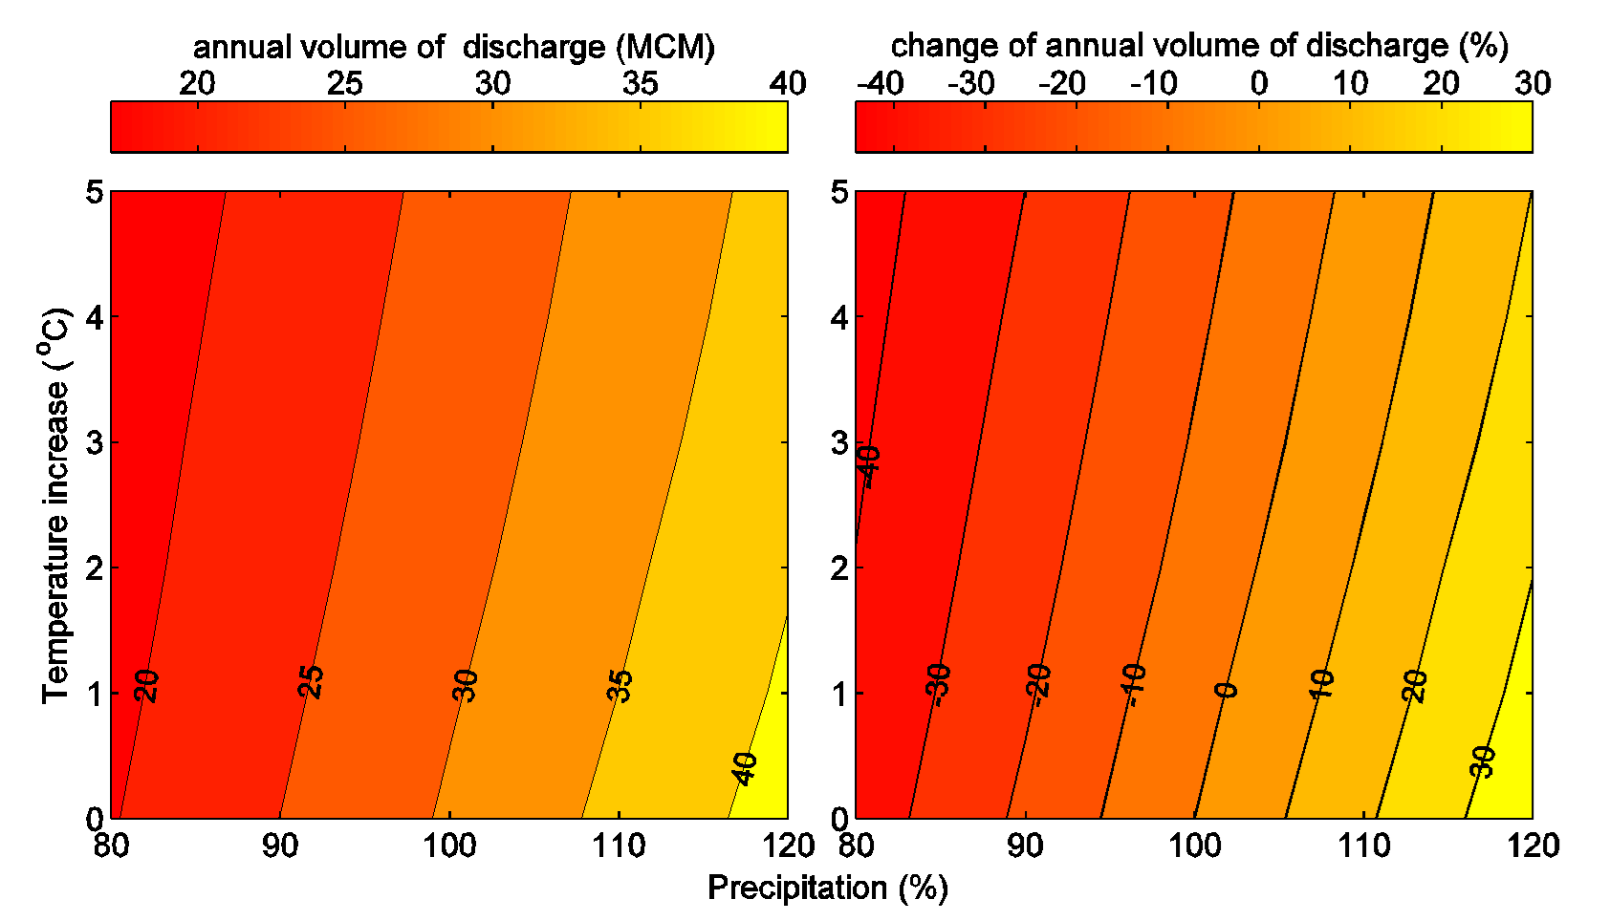
Wolf Creek, Yukon, Canada
Streamflow Impact
Alpine
ShrubTundra
Forest
Rasouli et al., 2014
17
Notes:
Peak annual snowpacks show a pronounced sensitivity to warming in wet years and a smaller sensitivity in drier years.

Slide 18
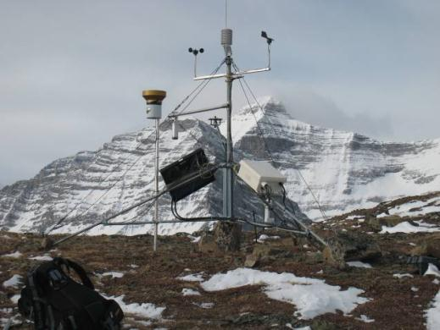
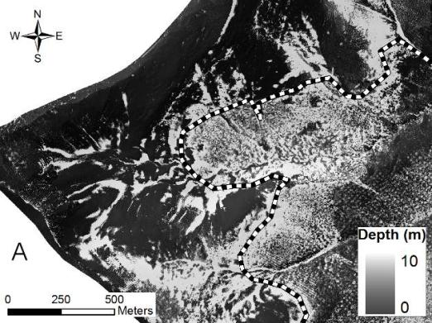
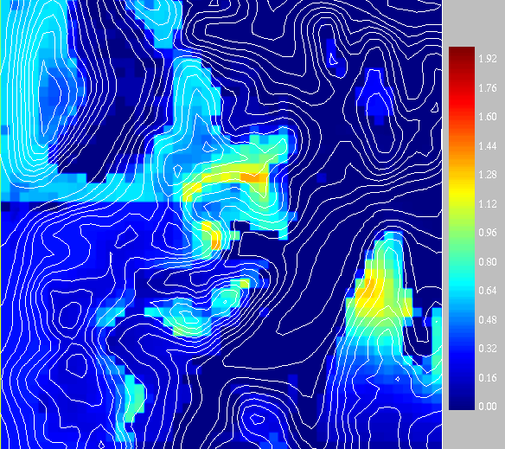
Integrated Alpine Observing & Predicting Systems - IAOPS
Instrumented alpine catchments with, remote sensing, atmospheric modelling, downscaling, data assimilation in order to better evaluate mountain water and energy exchange.

Slide 19
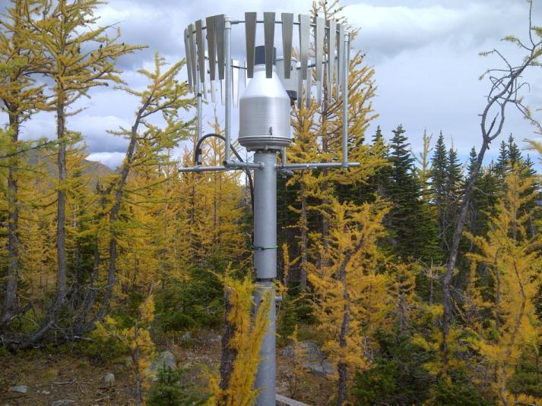
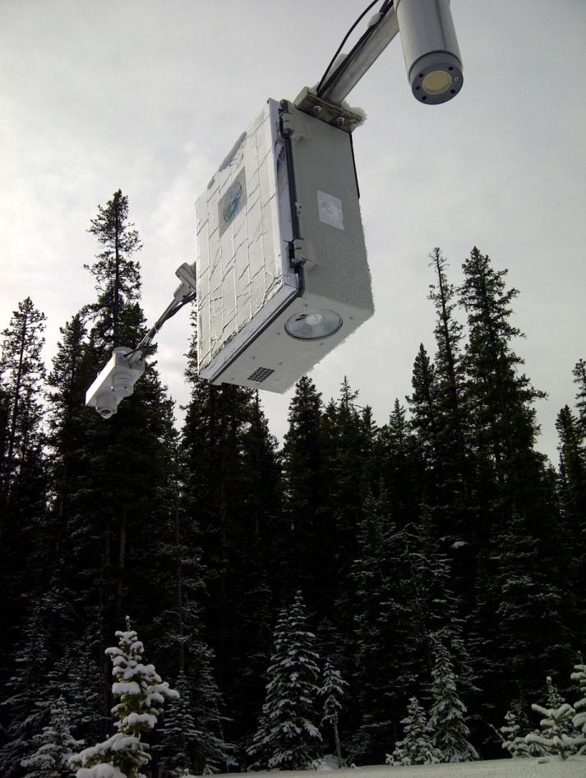
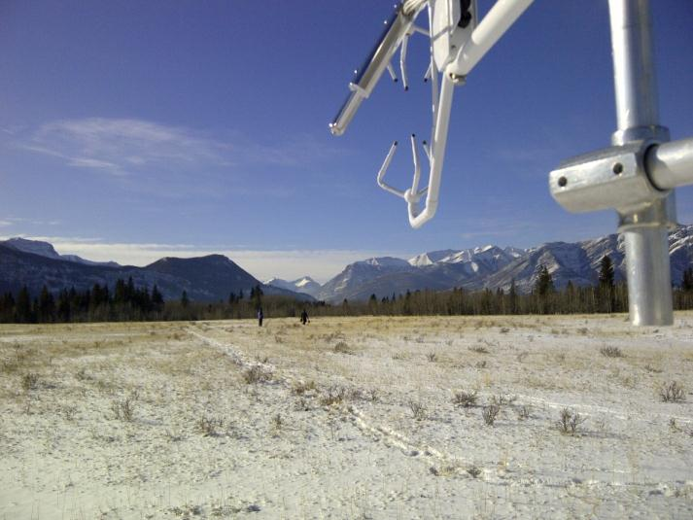
Improved Snow Measurements

Slide 20
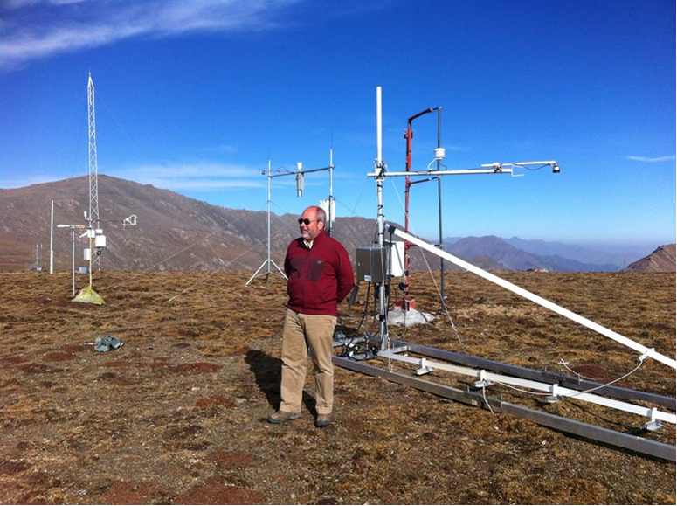
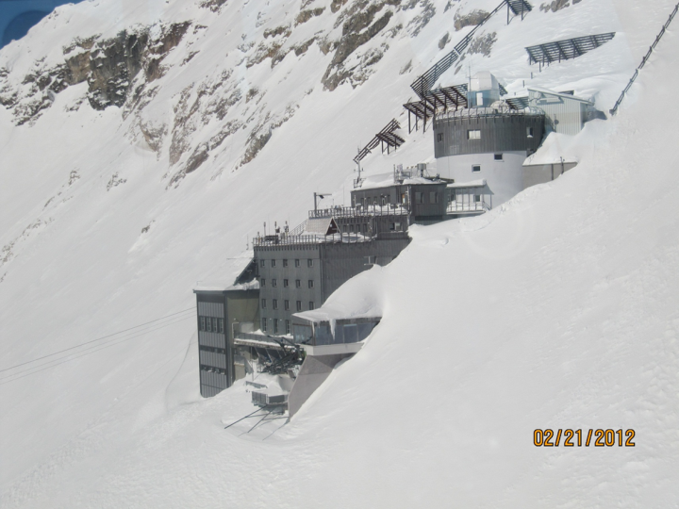
International Collaboration through Field & Model Experiments
Upper Heihe River Basin, 4150 m China
Schneefernerhaus, Zugspitze, 2650 m Germany

Slide 21


INARCH: International Network for Alpine Research Catchment Hydrology
Canada – Canadian Rockies & Yukon;
USA – Reynolds Creek, Idaho.
Chile - Upper Maipo & Upper Diguillín River Basins, Andes,
Germany – Schneefernerhaus & Zugspitze;
France – Arve Catchement, Col de Porte & Col du Lac Blanc;
Switzerland – Dischma & Weissfluhjoch;
Austria - OpAL Open Air Laboratory, Rofental
Spain – Izas, Pyrenees;
China – Upper Heihe River, Tibetan Plateau,
Nepal – Langtang Catchment, Himalayas
Integrated Alpine Observing and Predicting Systems (IAOPS),
initial sites to be considered

Slide 22
Linkages
UNESCO-International Hydrological Programme efforts on climate change impacts on snow, glacier and water resources within the framework of IHP-VIII (2014-2021) ‘Water Security: Responses to Local Regional and Global Challenges’.
International Commission for Snow and Ice Hydrology (IAHS-IUGG-ICSU)
GHP Proposed Crosscut Projects
  Precipitation phase
  Mountain precipitation

Slide 23
Next Steps
AGU Dec 2014 Sessions on snow hydrology and glacio-hydrology.
Initialisation of workshops to promote scientific integration
Joint field and modelling experiments through scientific exchanges, resulting in multi-authored papers
Joint development of an open-access Alpine Hydrological Modelling Toolbox.
Joint development of an open-access Alpine Downscaling Toolbox.
Promote the development of other catchments so that they can match the data availability requirements into the INACH initiative through scientific exchanges.
Snow hydrology model climate change sensitivity experiments with the Toolbox: Spain, USA, Germany, Canada (so far)
Model snow process evaluation and algorithm intercomparison exercises using archived datasets to evaluate the prevalence and operation of various snow accumulation, redistribution and ablation processes in differing global alpine environments.

Slide 24
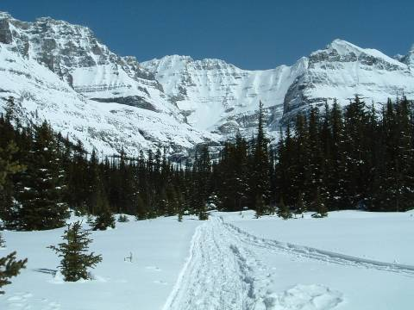
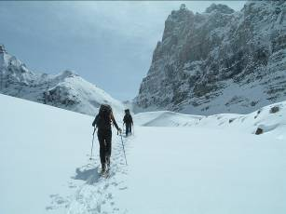
Funding Needs
Collaborators in INARCH are expected to have their primary scientific research funded to contribute to this project and operate Integrated Alpine Observing and Predicting Systems (where applicable).
Core funding to the project is needed to facilitate collaboration and central project operation through:
Travel funding support for workshops, scientific exchanges, joint field and modelling experiments,
User support for and central modelling development of Modelling and Downscaling Toolboxes
Data management of the data repository and model outputs for intercomparison experiments
Outreach and training activities.

